Slide 1



Capstone Project
Google Analytics Customer Revenue
Fin
Techs
FinTechs presenters:
Hassan Salam, Jonathan Preiss, Sina Lotfiomran, Davain Pablo Edwards
27.4.2021
Notes:
Our challenge is to analyze a Google Merchandise Store customer dataset to predict revenue per customer.
The aim is that the outcome will be more actionable operational changes and a better use of marketing budgets for those companies who choose to use data analysis on top of Google Analytics data.
The 80/20 rule has proven true for many businesses–only a small percentage of customers produce most of the revenue. As such, marketing teams are challenged to make appropriate investments in promotional strategies.
Our main project is about Google Analytics customer behavior and main goal is to help publisher to predict if a customer will make a purchase and how much revenue the customer will generate regarding his/her sessions.

Slide 2


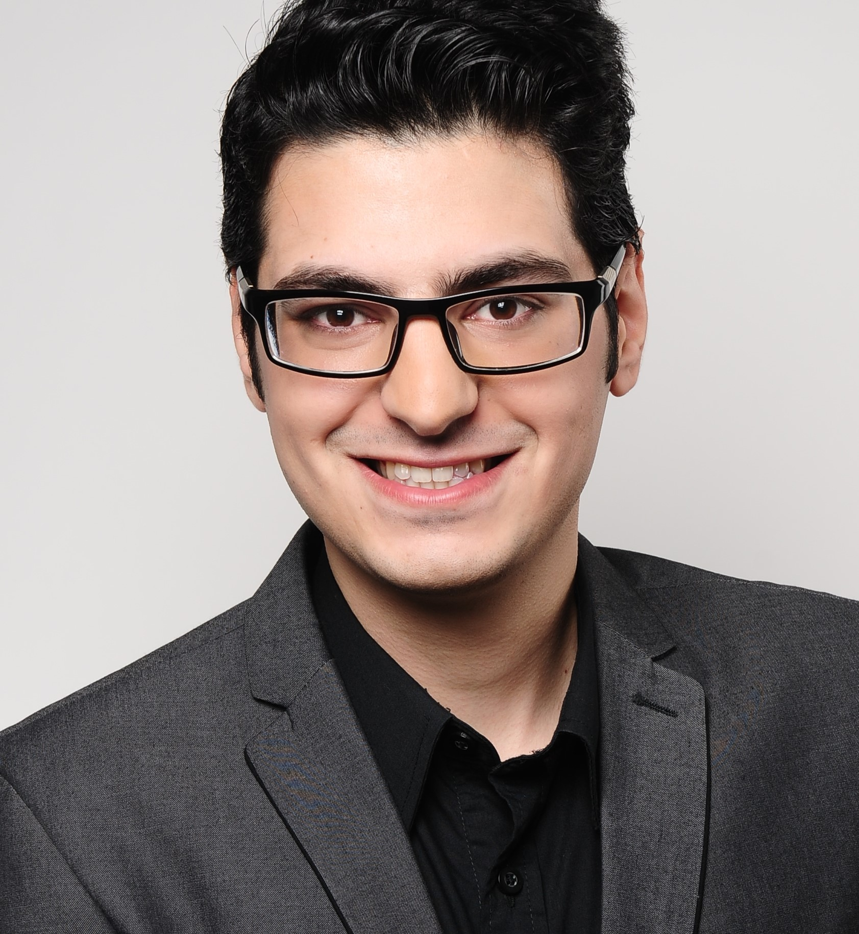

The Team: FinTechs
Fin
Techs
Hassan Salam
Physics Researcher
Electronics Eng.
Sales Analyst
Jonathan Preiss
Online Marketing
Business Development
Future Data Scientist
Sina Lotfiomran
Mechanical Engineer
Research Assistant
DS with Engineering
Davain Pablo Edwards
Experienced Full Stack Developer
Trained Computer Science Expert
Future Data Scientist

Slide 3
Agenda
Fin
Techs
Business Case
Objectives & Approach
Our Workflow
Data Description
Metric
Exploratory Data Analysis
Modeling
Future Work
Notes:
Capstone projects possess:
baseline model implemented
which metric and why?
cross validation
grid search (MLflow)
error analysis
Interpret your result:
How much better is your final model compared to the baseline?
Do your results meet the stakeholders demands/expectations?

Slide 4



Business Case
Fin
Techs
Notes:
Capstone projects possess:
baseline model implemented
which metric and why?
cross validation
grid search (MLflow)
error analysis
Interpret your result:
How much better is your final model compared to the baseline?
Do your results meet the stakeholders demands/expectations?

Slide 5
Business Case
Fin
Techs
Stakeholder:
Publishers who wish to promote their products on the google merchandise store.
Goal:
Analyse the publishers online campaigns by given them insights for USA market, which will be able to predict if a customer will made a purchase or not and how much revenue the customer will generated.

Slide 6
Agenda
Fin
Techs
Business Case
Objectives & Approach
Our Workflow
Data Description
Metric
Exploratory Data Analysis
Modeling
Future Work
Notes:
Capstone projects possess:
baseline model implemented
which metric and why?
cross validation
grid search (MLflow)
error analysis
Interpret your result:
How much better is your final model compared to the baseline?
Do your results meet the stakeholders demands/expectations?

Slide 7
Objective
Our Approach
Fin
Techs
The goal was to analyze the customers total revenues for the period of May 1st 2018 to October 15th 2018 to predict the revenues on future customer behaviors.
First we trained our data based on the Sessions features
Then, we predicted the revenue per session
Finally, We aggregated revenue of sessions per Customer.

Slide 8
Agenda
Fin
Techs
Business Case
Objectives & Approach
Our Workflow
Data Description
Metric
Exploratory Data Analysis
Modeling
Future Work
Notes:
Capstone projects possess:
baseline model implemented
which metric and why?
cross validation
grid search (MLflow)
error analysis
Interpret your result:
How much better is your final model compared to the baseline?
Do your results meet the stakeholders demands/expectations?

Slide 9




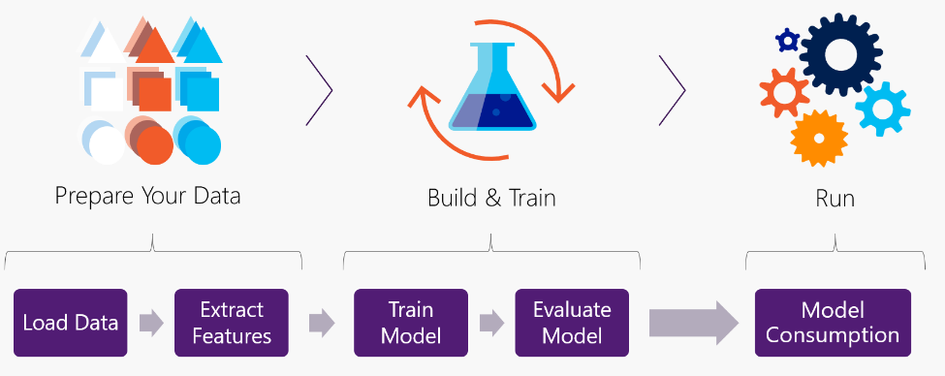
Our Workflow:
Fin
Techs
Cleaning
→
Preprocessing
→
Feature Engineering
→
Regression
→
Evaluation
Removing unwanted data.
Preparing the data.
Calculating and creating new features.
Creating the right model.
Review the model and interpreting results.
Iteration

Slide 10
Our Workflow:
Fin
Techs
Cleaning
→
Preprocessing
→
Feature Engineering
→
Regression
→
Evaluation
Removing unwanted data.
Preparing the data.
Calculating and creating new features.
Creating the right model.
Review the model and interpreting results.
Iteration

Slide 11
Our Workflow:
Fin
Techs
Cleaning
→
Preprocessing
→
Feature Engineering
→
Regression
→
Evaluation
Removing unwanted data.
Preparing the data.
Calculating and creating new features.
Creating the right model.
Review the model and interpreting results.
Iteration

Slide 12
Our Workflow:
Fin
Techs
Cleaning
→
Preprocessing
→
Feature Engineering
→
Regression
→
Evaluation
Removing unwanted data.
Preparing the data.
Calculating and creating new features.
Creating the right model.
Review the model and interpreting results.
Iteration

Slide 13
Our Workflow:
Fin
Techs
Cleaning
→
Preprocessing
→
Feature Engineering
→
Regression
→
Evaluation
Removing unwanted data.
Preparing the data.
Calculating and creating new features.
Creating the right model.
Review the model and interpreting results.
Iteration

Slide 14
Our Workflow:
Fin
Techs
Cleaning
→
Preprocessing
→
Feature Engineering
→
Regression
→
Evaluation
Removing unwanted data.
Preparing the data.
Calculating and creating new features.
Creating the right model.
Review the model and interpreting results.
Iteration

Slide 15
Our Workflow:
Fin
Techs
Cleaning
→
Preprocessing
→
Feature Engineering
→
Regression
→
Evaluation
Removing unwanted data.
Preparing the data.
Calculating and creating new features.
Creating the right model.
Review the model and interpreting results.
Iteration

Slide 16
Agenda
Fin
Techs
Business Case
Objectives & Approach
Our Workflow
Data Description
Metric
Exploratory Data Analysis
Modeling
Future Work
Notes:
Capstone projects possess:
baseline model implemented
which metric and why?
cross validation
grid search (MLflow)
error analysis
Interpret your result:
How much better is your final model compared to the baseline?
Do your results meet the stakeholders demands/expectations?

Slide 17
Data Overview:
Fin
Techs
Our dataset contains:
1.7 M Observations
29 Features
33 GB Size
Some Features:
Total Page View
Total hits
week
Visit Number
Geonetwork - Country
Geonetwork - Domain
Geonetwork - City
Geonetwork - Region
Channel Grouping
Device operating System

Slide 18
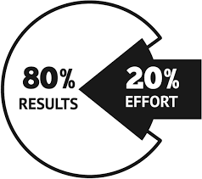
80% - 20% Rule In Business
Fin
Techs
The 80-20 rule, is a rule which asserts that 80% of outcomes, result from 20% of all causes.
In business, a goal of the 80-20 rule is to identify inputs that are potentially the most productive and make them the priority.
In E-commerce businesses, it is more crucial to know the behaviour of your Sessions…
… even more at Corona time!
Notes:
80% of consequences come from 20% of the causes.

Slide 19
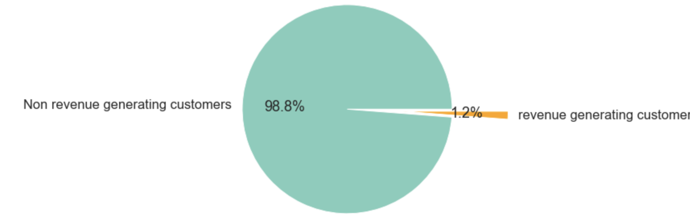
Revenue Transactions Distributions
Fin
Techs
The distribution of revenue among sessions:
Non revenue
generating Sessions
Revenue generating Sessions
In our e-business it seems like 99% - 1% Rule
The struggle is real!
Notes:
So if we look at the distribution of the revenues made, we see only 1 percent of the total actually generate revenue.
So we had to work with this huge imbalance in the dataset which was also quite challenging.

Slide 20
Agenda
Fin
Techs
Business Case
Objectives & Approach
Our Workflow
Data Description
Metric
Exploratory Data Analysis
Modeling
Future Work
Notes:
Capstone projects possess:
baseline model implemented
which metric and why?
cross validation
grid search (MLflow)
error analysis
Interpret your result:
How much better is your final model compared to the baseline?
Do your results meet the stakeholders demands/expectations?

Slide 21
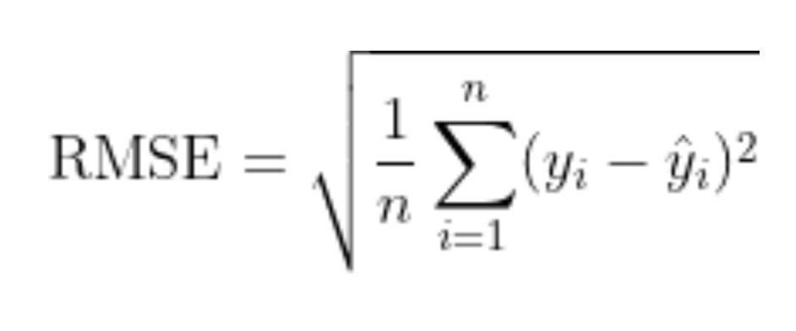
Metric
,,totals.transactionRevenue” Measure of predicting performance.
Fin
Techs
Root Mean Squared Error:
ŷ (predicted-values): Is the natural log of the predicted revenue for a customer.
y (actual-values): Is the natural log of the actual summed revenue value plus one.

Slide 22
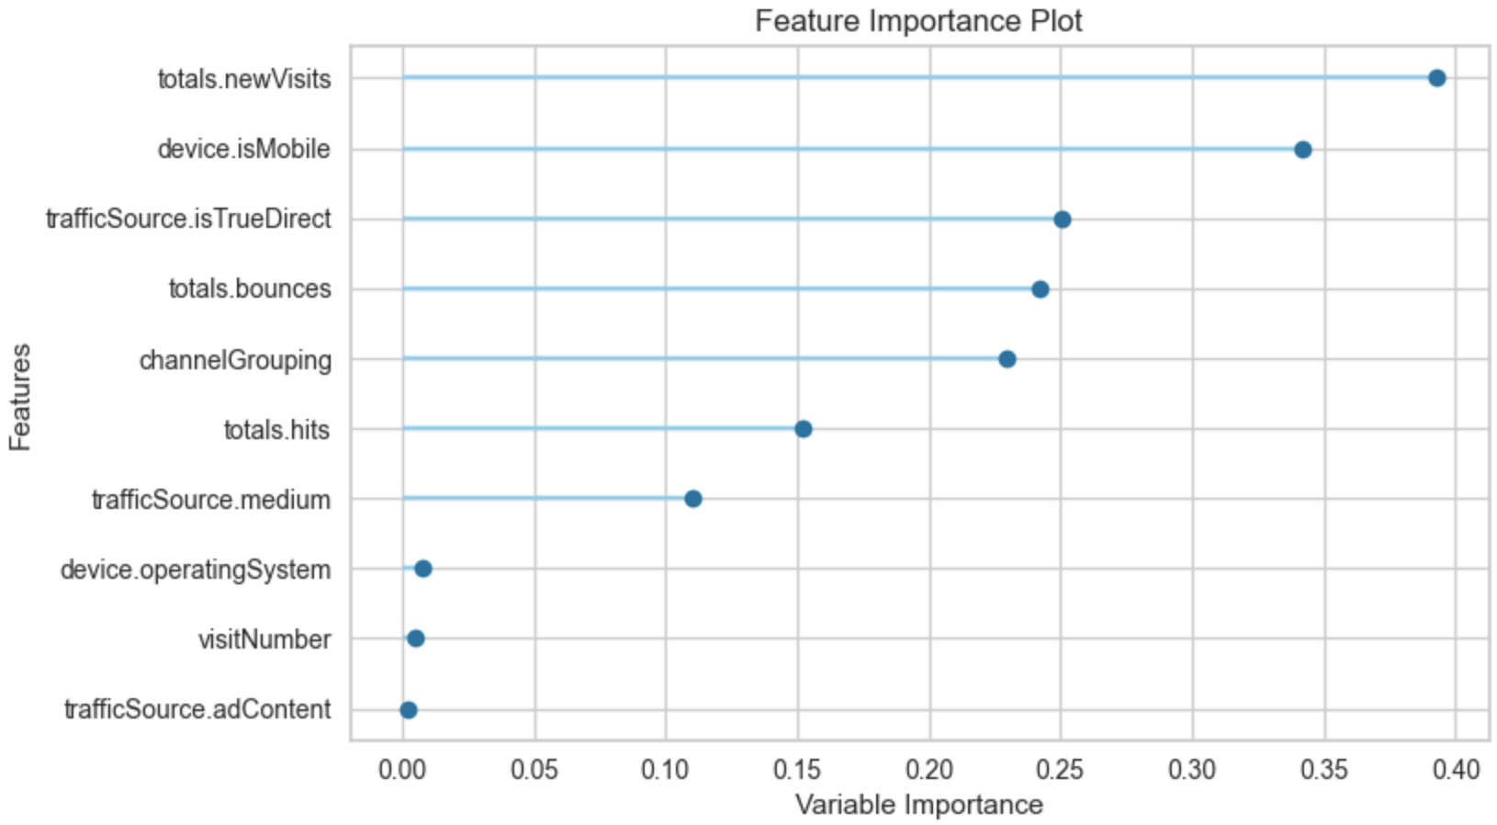
Baseline Model
Outcome:
Fin
Techs
All feature included
No feature engineering
Use lineare regression
No hyper tuning
No cross validation
RMSE: 2.05

Slide 23
Agenda
Fin
Techs
Business Case
Objectives & Approach
Our Workflow
Data Description
Metric
Exploratory Data Analysis
Modeling
Future Work
Notes:
Capstone projects possess:
baseline model implemented
which metric and why?
cross validation
grid search (MLflow)
error analysis
Interpret your result:
How much better is your final model compared to the baseline?
Do your results meet the stakeholders demands/expectations?

Slide 24
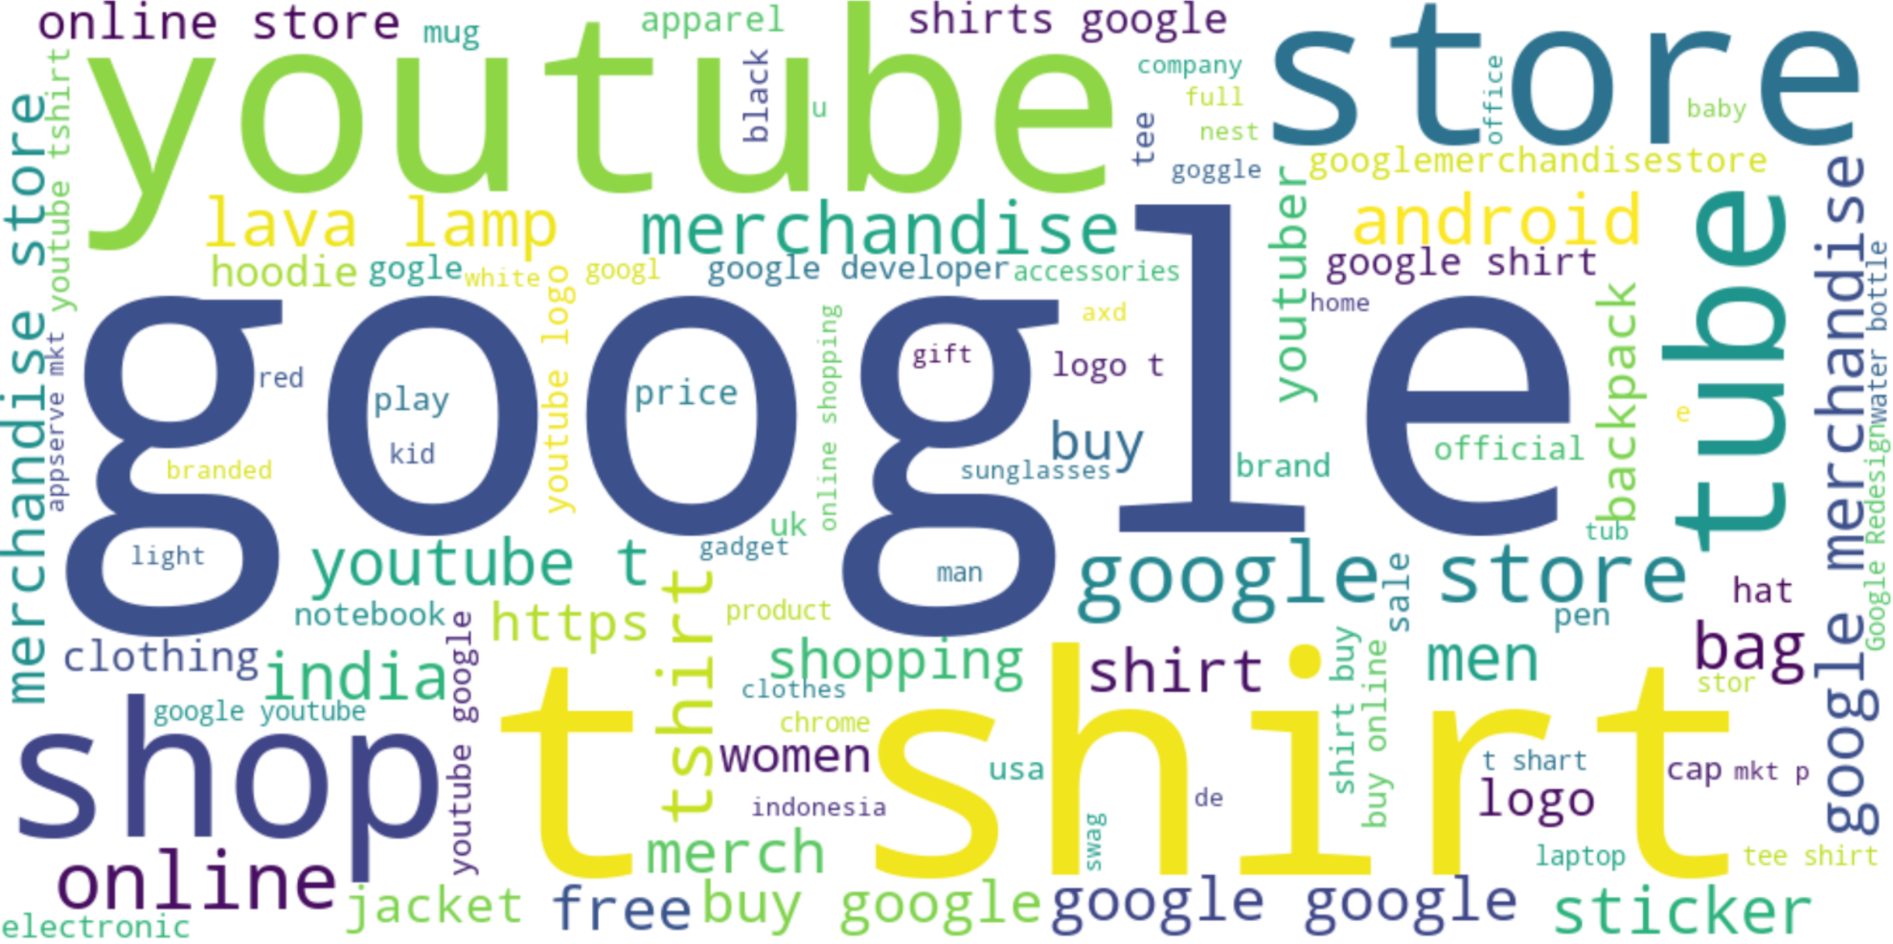
Keywords Customers type
Fin
Techs
Most searches words are:
google
youtube
store
t-shirt

Slide 25
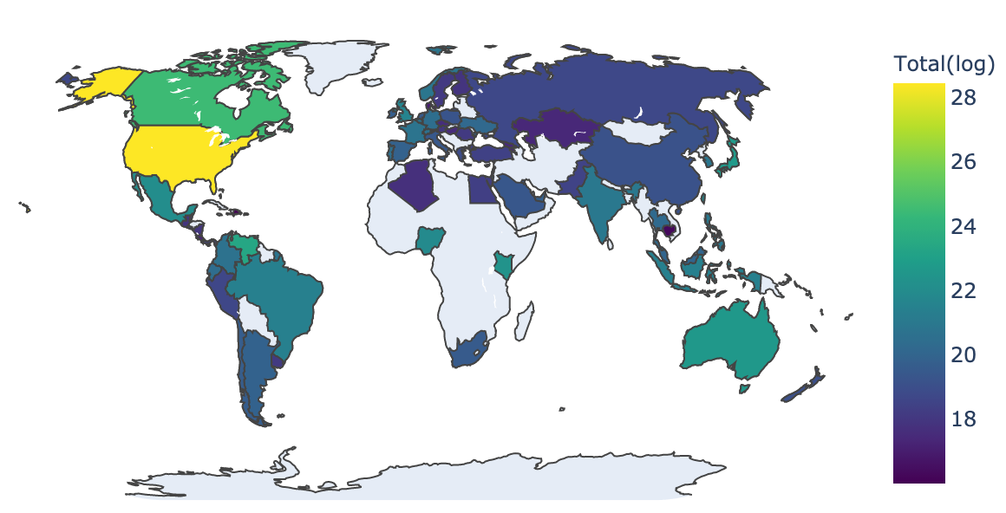
Total Revenue Transactions Per Country
Fin
Techs
The majority of the revenue is generated from the Americas.
Few revenue generate from Asia.

Slide 26
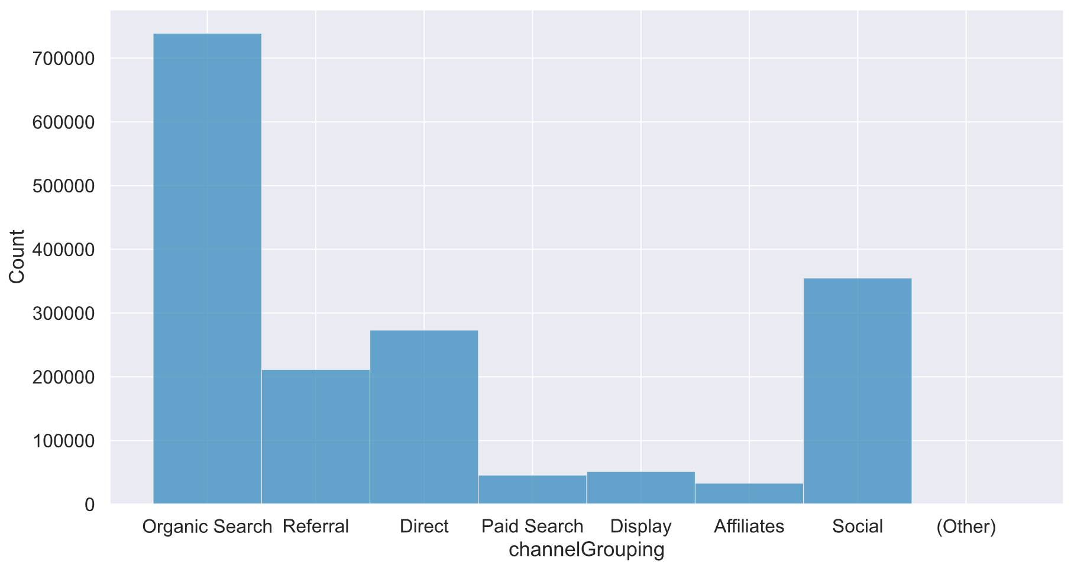
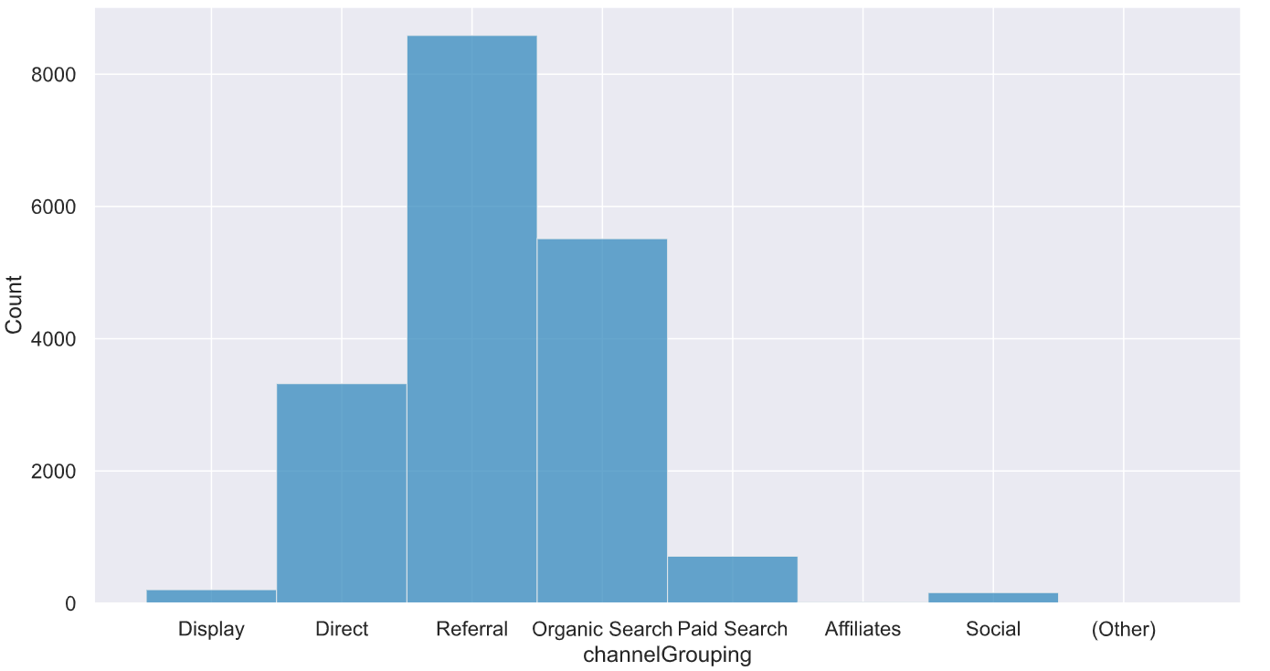

1. Sessions coming from "Organic search" generate more Revenue
Fin
Techs
Channel distribution for Total Sessions:
Channel distribution for Revenue Sessions:
Total sessions includes Revenue + Non Revenue Sessions and come through Organic Search.
However, the number of revenue generating Sessions from Referral is the highest
Organic Search: Non paid ads.

Slide 27
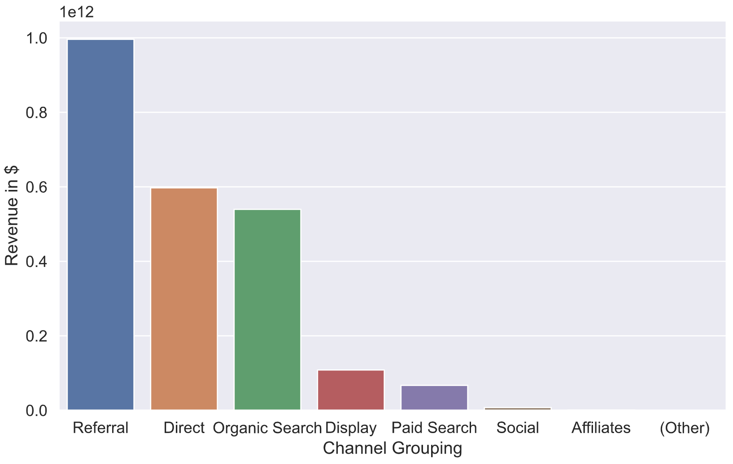

Sessions coming from "Organic search" generate more Revenue
Fin
Techs
Revenue Transactions per channel:
Referral generate more Revenue even though the number of Sessions from Organic-Search is higher

Slide 28
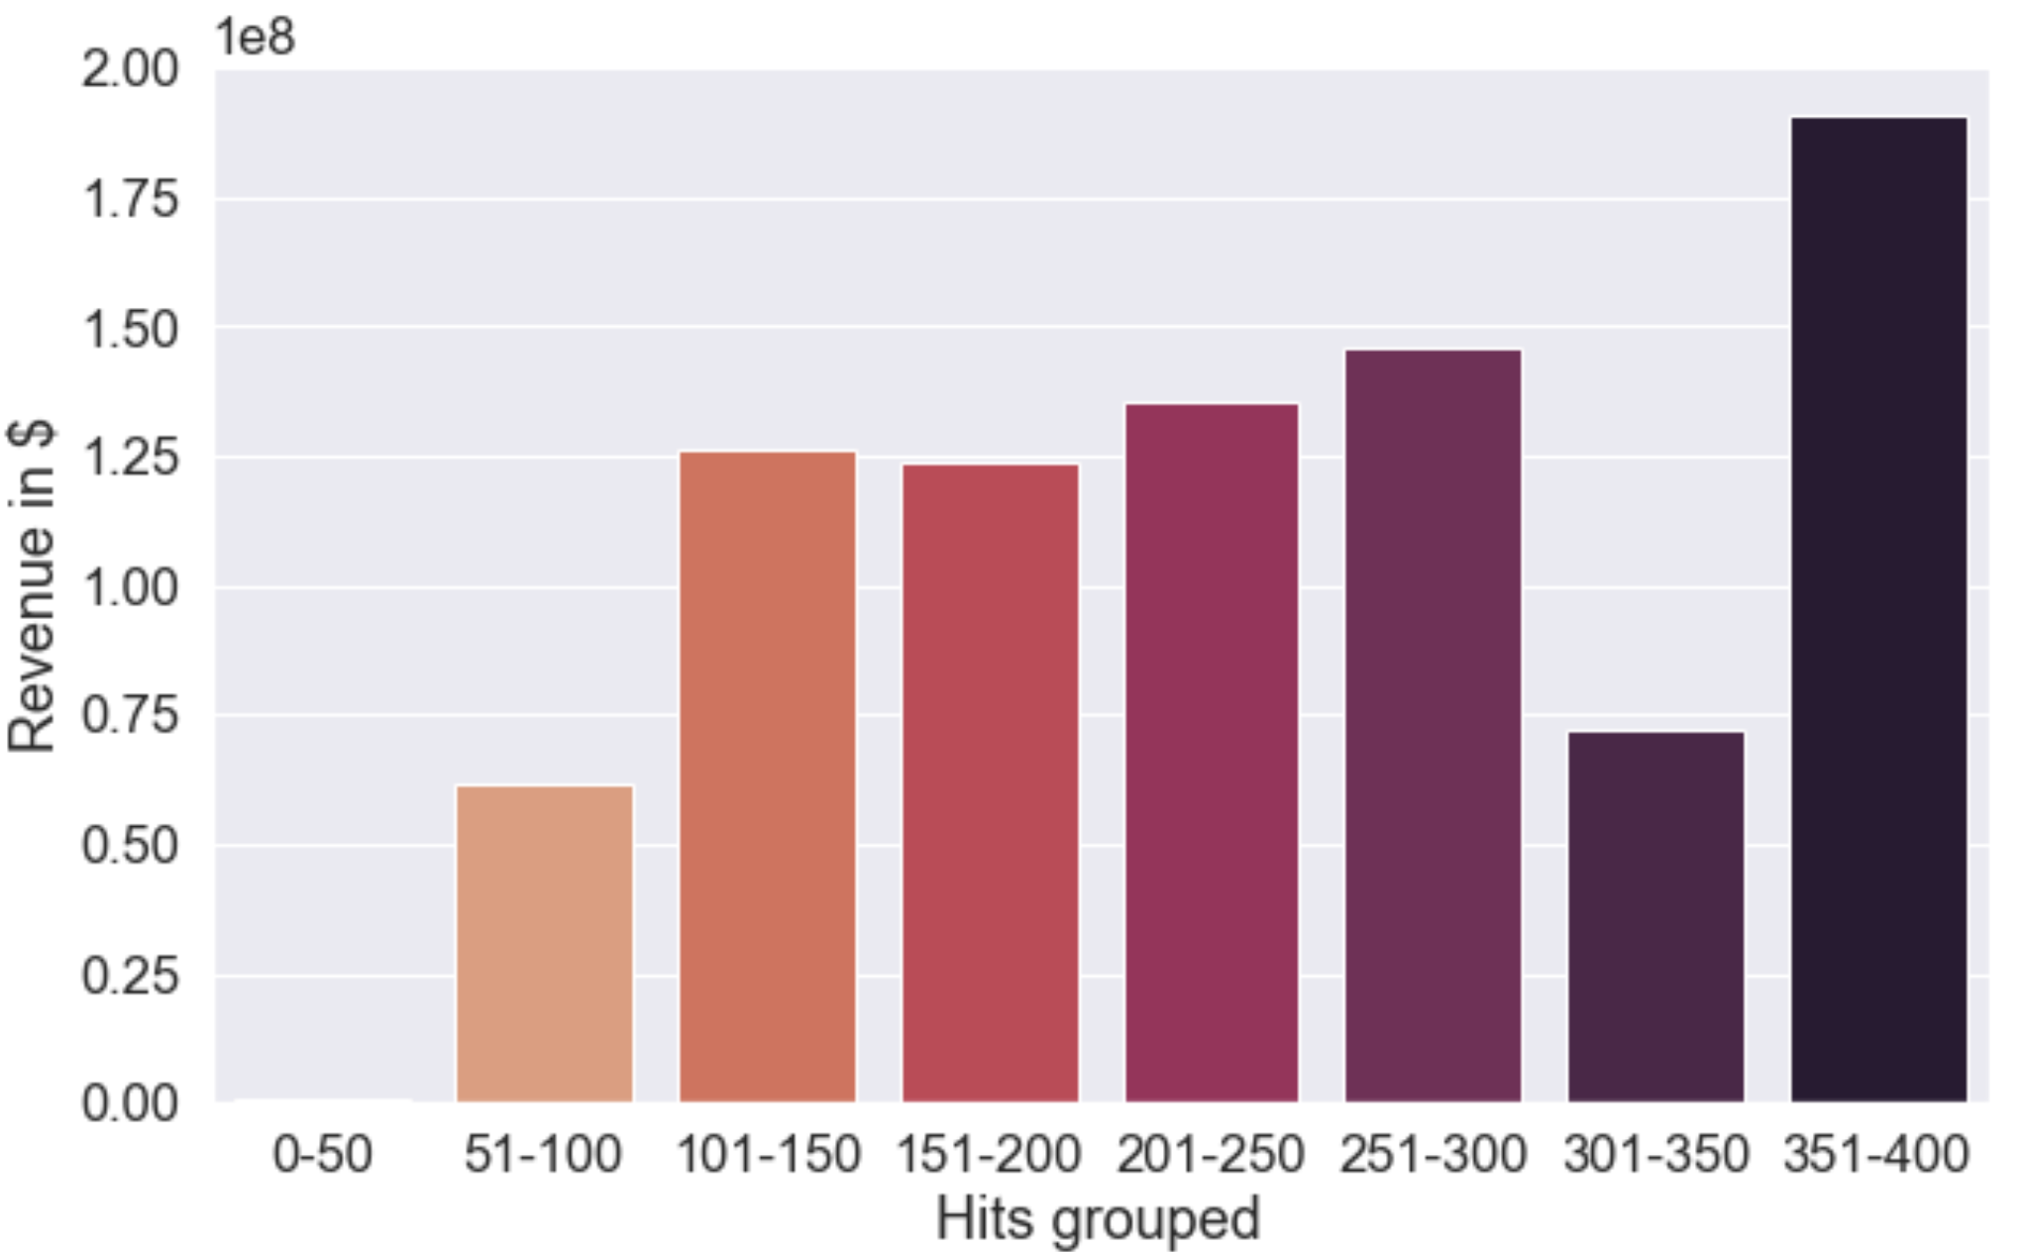
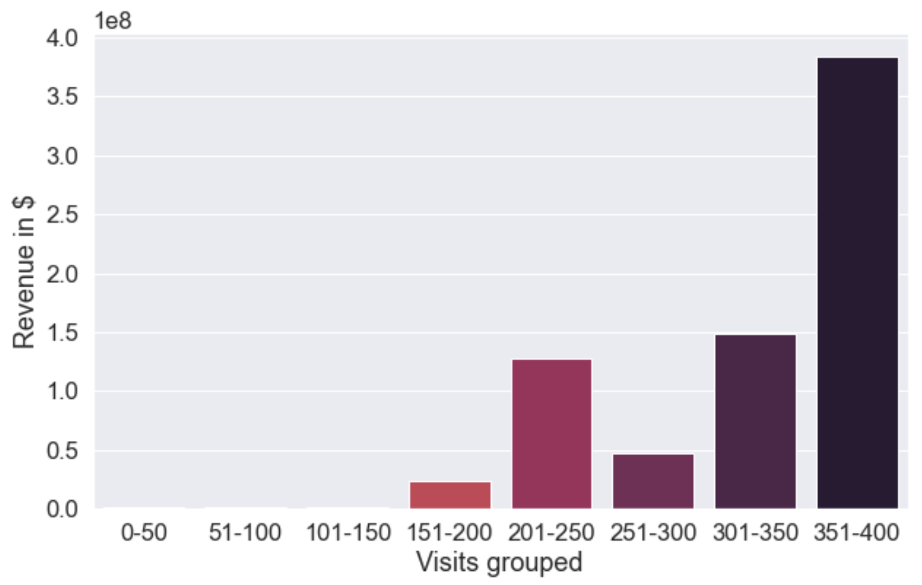
2. Sessions with higher store visits made more Revenue on average
Fin
Techs
The average Revenue per number of hits group :
The average Revenue per number of visits group:
The average revenue is generated from more number of hits and visits.
Visits: shows the number of times a user visited store.
Hits: shows the number of times a store (or) product page URL has accessed.

Slide 29
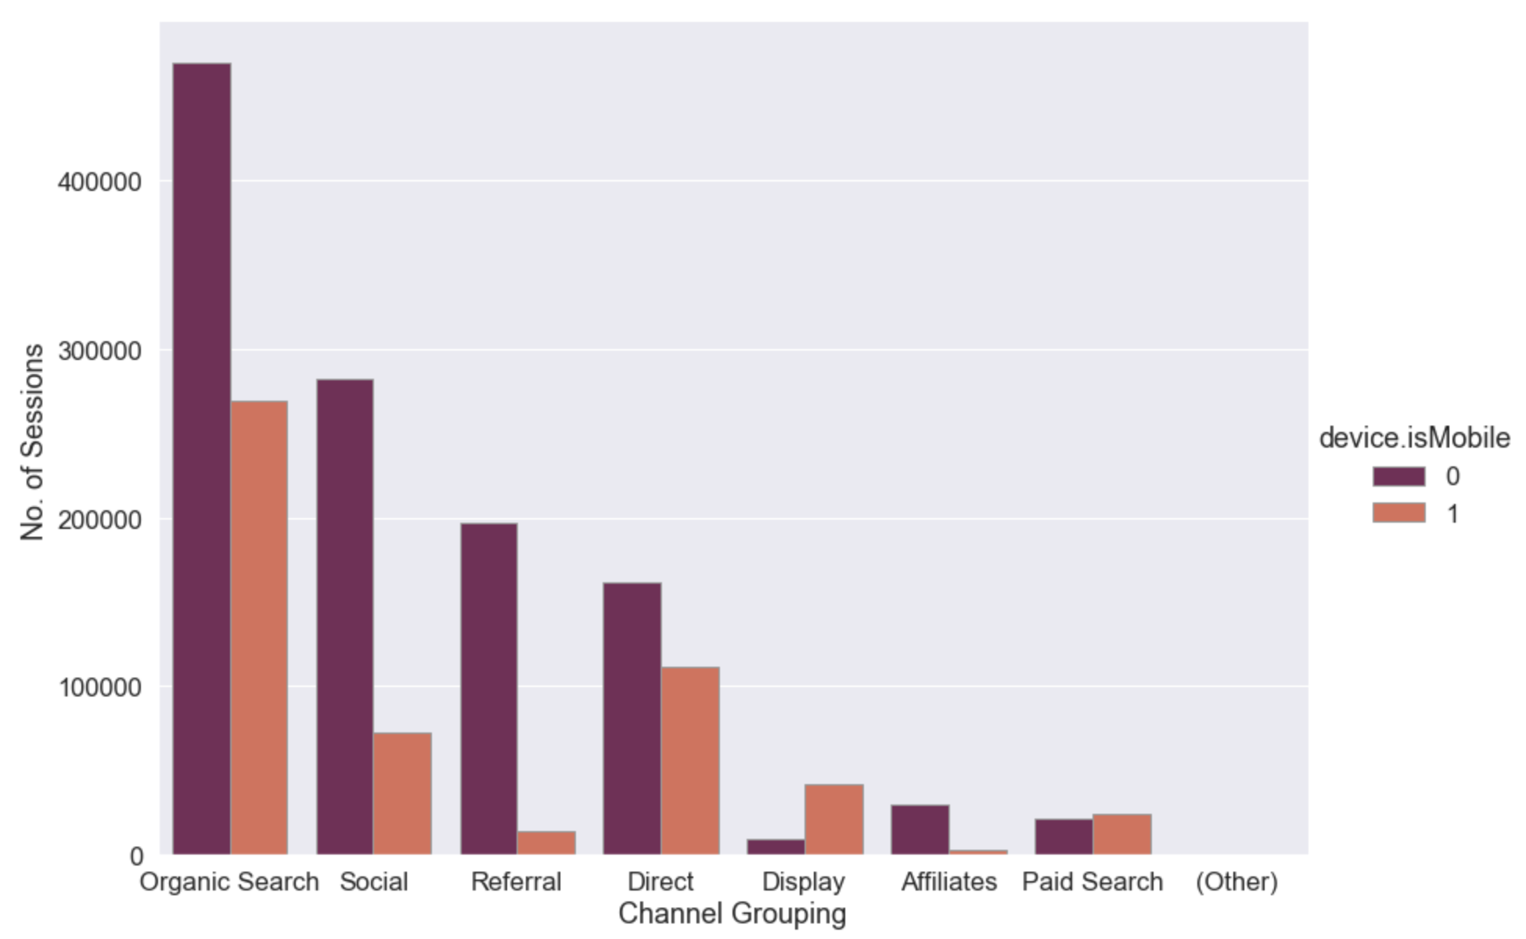
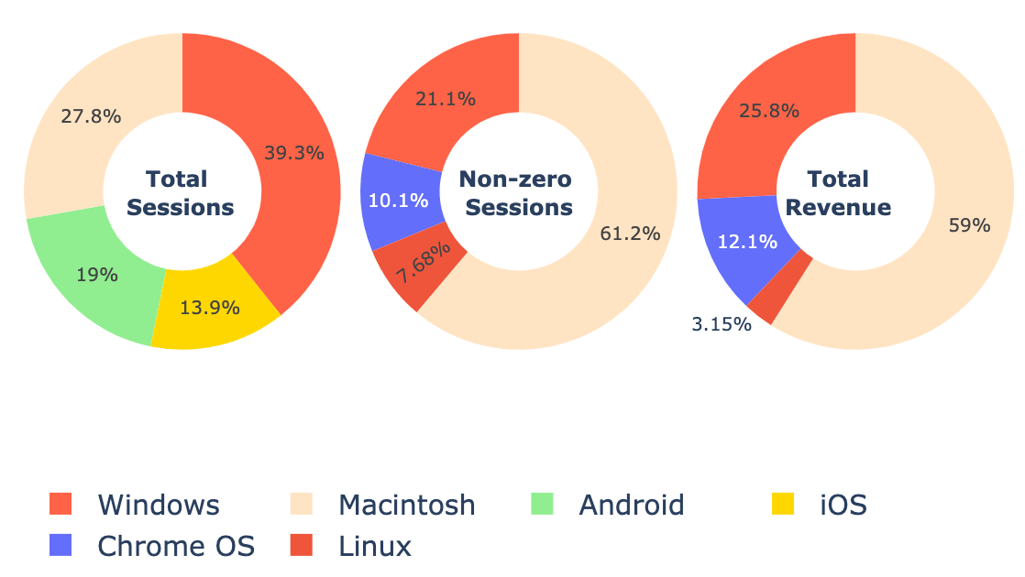
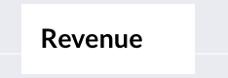
3. Most of the Sessions are through mobile devices
Fin
Techs
Total number of Sessions per channel:
Mac Users Sessions are higher in number and generate more Revenue
1 = Mobile
0 = Non Mobile

Slide 30
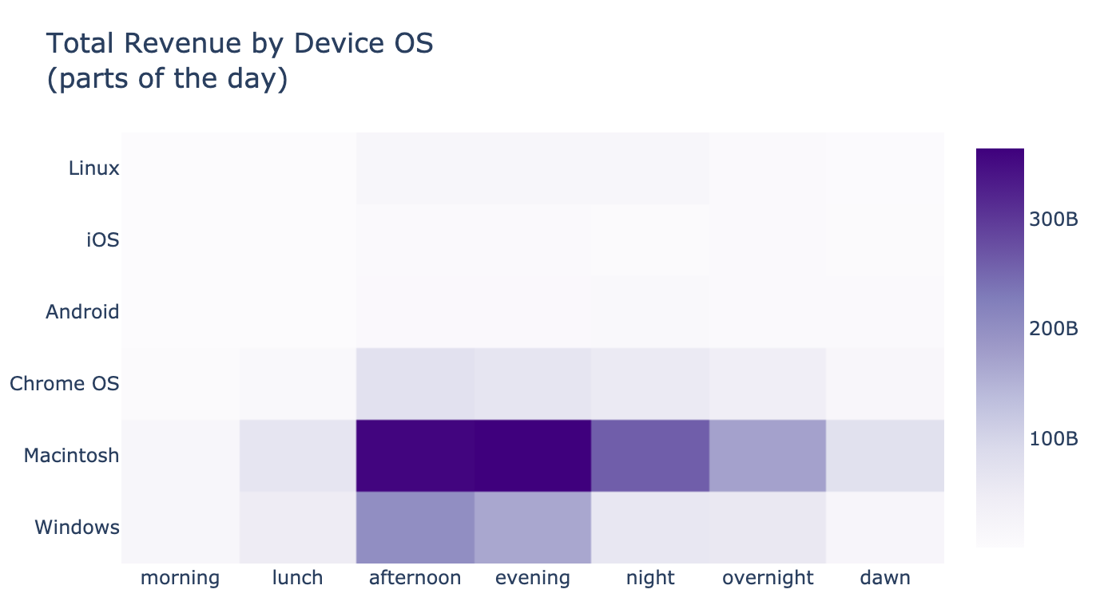
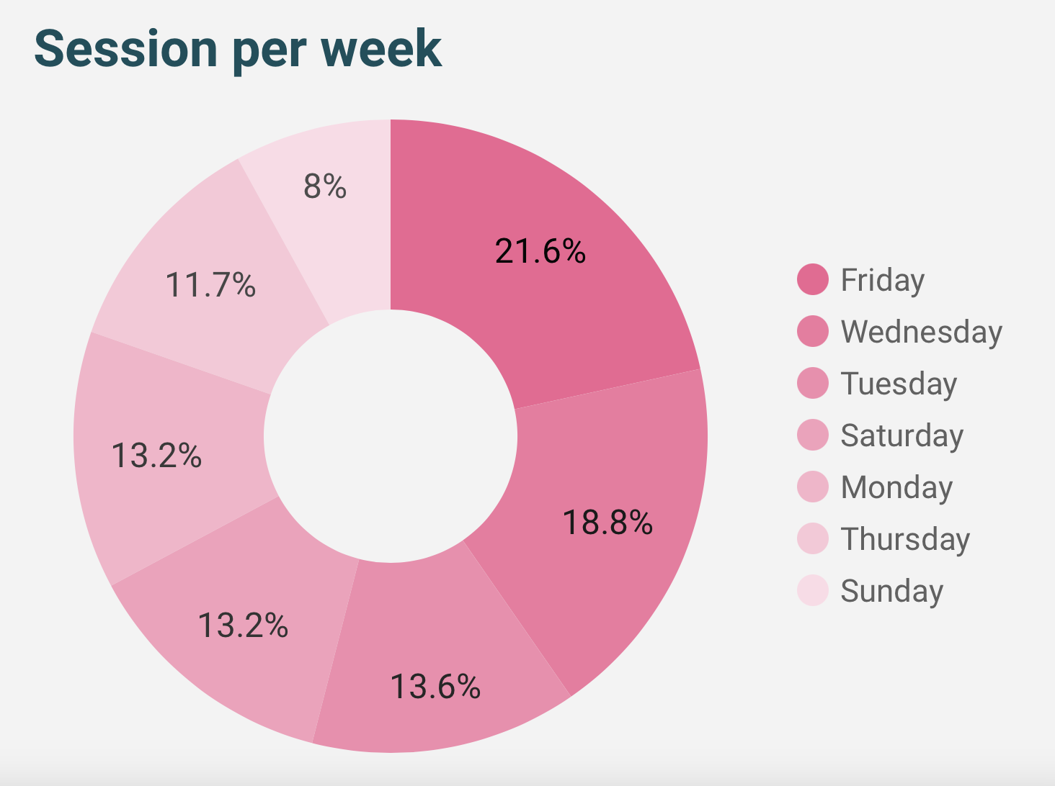
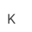
No. of Revenue Session at different parts of Day and Week
Fin
Techs
Sessions per day

Slide 31
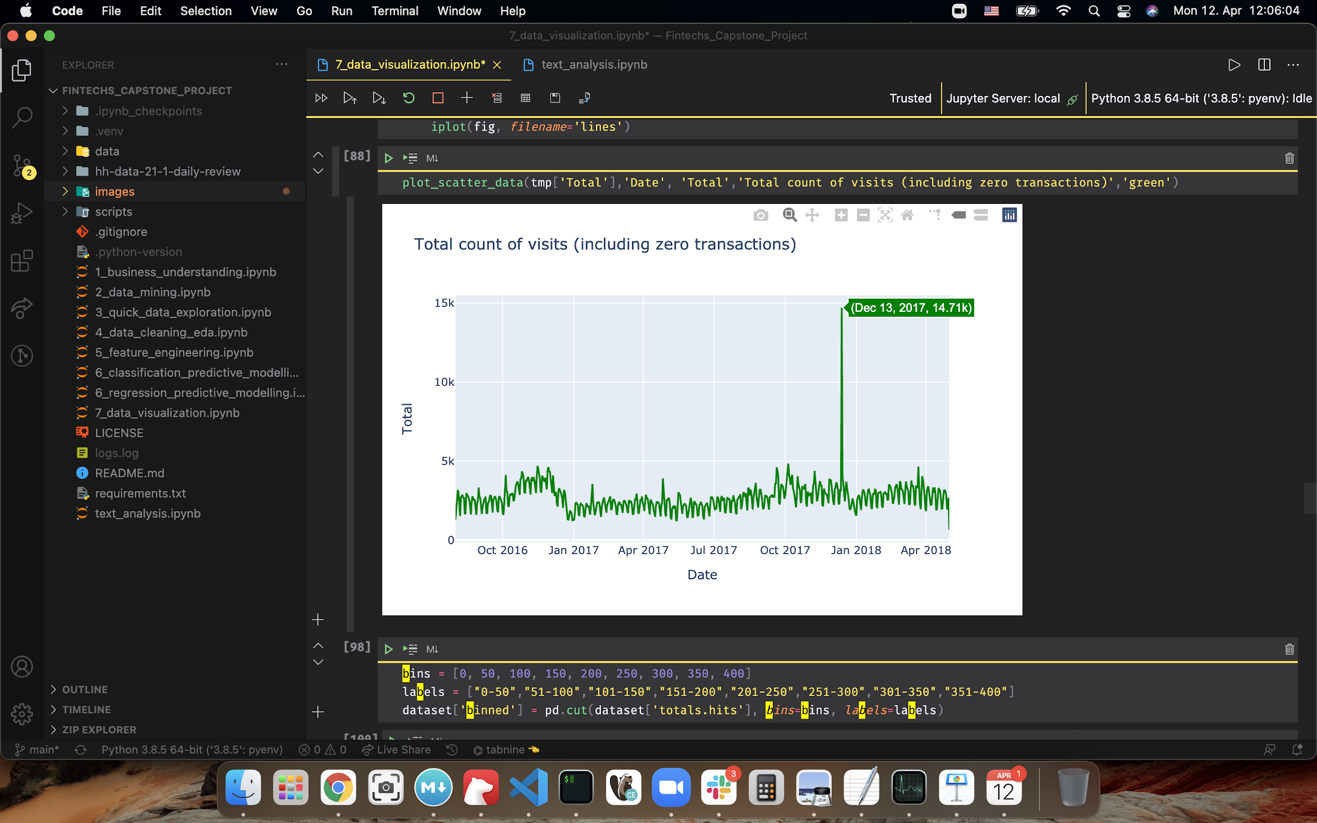
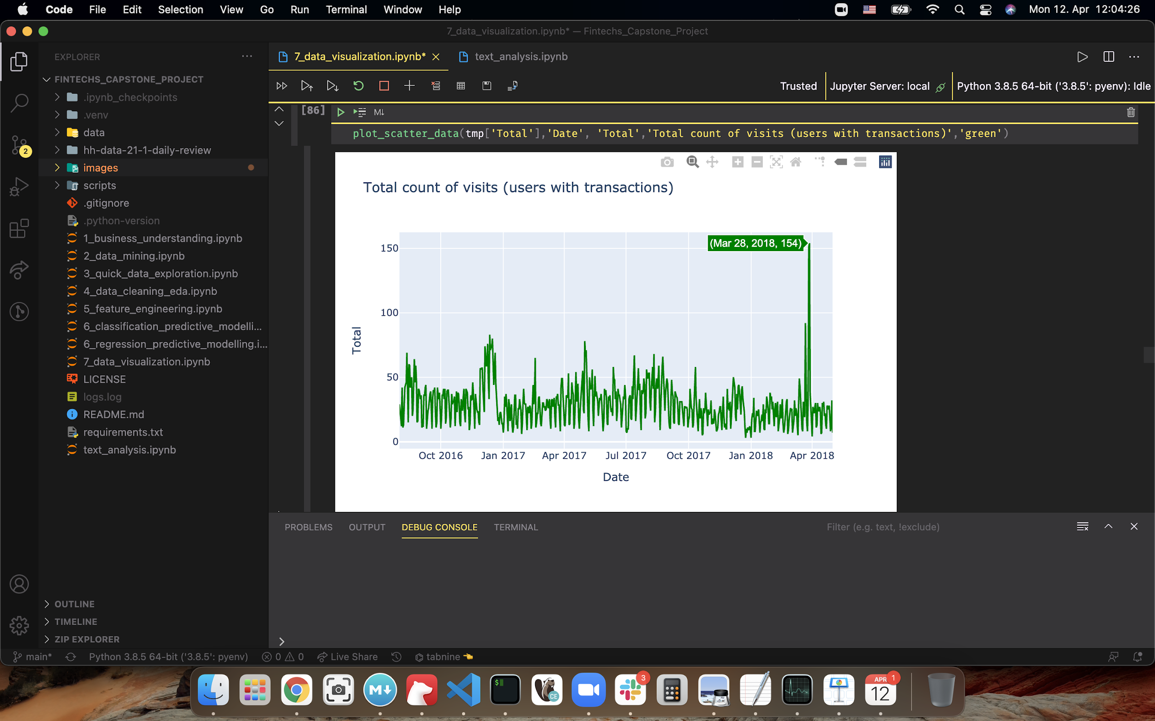

No. of Sessions per Date
Fin
Techs
Total Sessions over time (Rev + Non Rev):
Revenue based Session over time:
Session
in USD
High Sessions recorded in December 2017
High peek on March 2018 for Sessions with Revenue!

Slide 32
Highlights Insights
Fin
Techs
The USA market is the most profitable.
Organic search generate the most traffic.
Most number of the Revenue Transactions come from Referral.
Mac -users are the strongest in terms of revenue, regardless the channel.
Higher session traffic on Fridays and in Afternoon and Evenings.

Slide 33
Agenda:
Fin
Techs
Business Case
Objectives & Approach
Our Workflow
Data Description
Metric
Exploratory Data Analysis
Modeling
Future Work
Notes:
Capstone projects possess:
baseline model implemented
which metric and why?
cross validation
grid search (MLflow)
error analysis
Interpret your result:
How much better is your final model compared to the baseline?
Do your results meet the stakeholders demands/expectations?

Slide 34
Methodology and Modeling
Fin
Techs
Classification Model (Revenue or non-Revenue Sessions).
Regression Model (The Value of Sessions Revenue).
Calculating Target Value by multiplying results from two models.
Aggregate predicted Total Revenue Transactions per Customers.

Slide 35
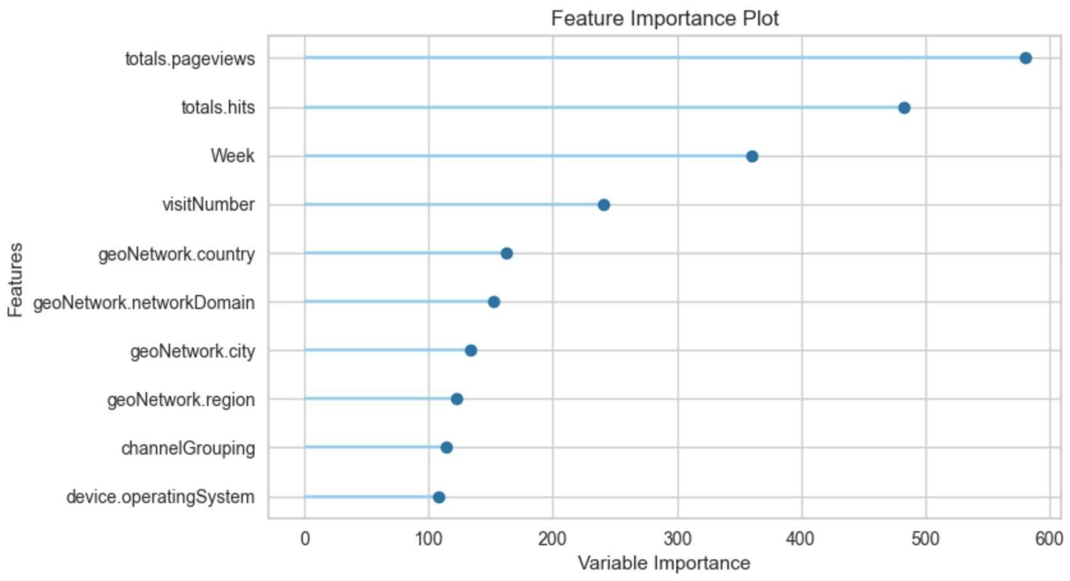
Feature Importance for our Model
Fin
Techs

Slide 36
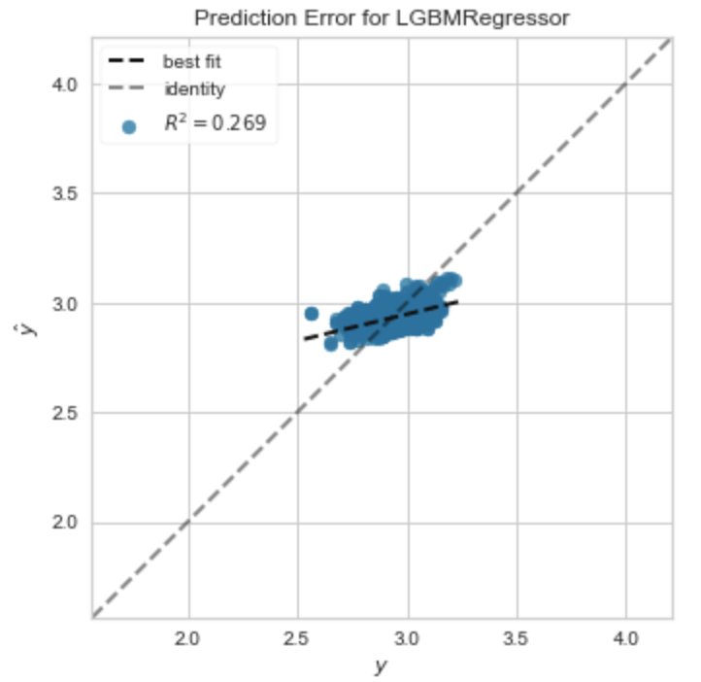
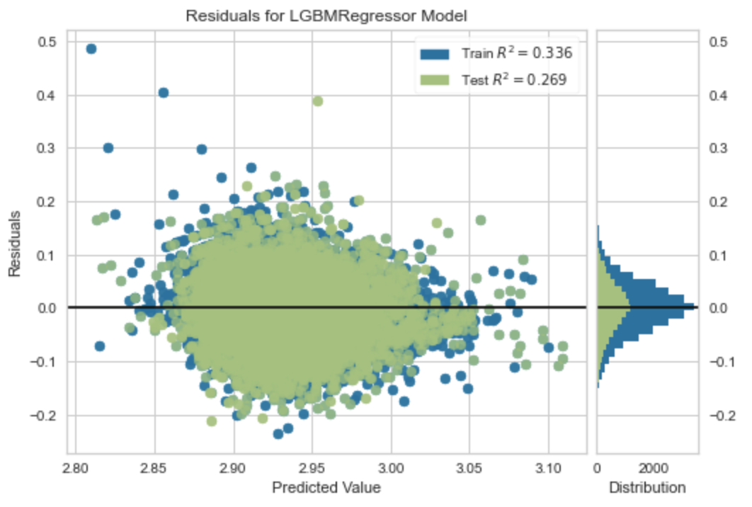
Error Analysis for our final model
Revenue generating analysis
Fin
Techs

Slide 37
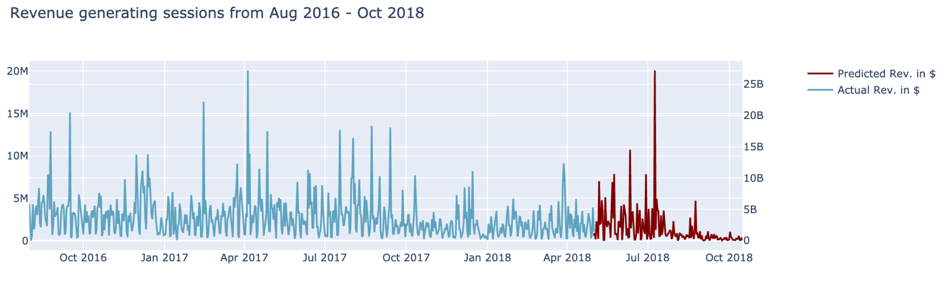
Results of the Model
Fin
Techs

Slide 38
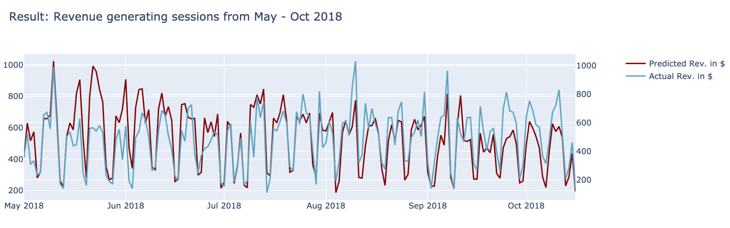
How well did our model predict?
Fin
Techs
Our model RMSE: 1.71
Improved: 16.5%
Baseline RMSE: 2.05

Slide 39
Agenda:
Fin
Techs
Business Case
Objectives & Approach
Our Workflow
Data Description
Metric
Exploratory Data Analysis
Modeling
Future Work
Notes:
Capstone projects possess:
baseline model implemented
which metric and why?
cross validation
grid search (MLflow)
error analysis
Interpret your result:
How much better is your final model compared to the baseline?
Do your results meet the stakeholders demands/expectations?

Slide 40
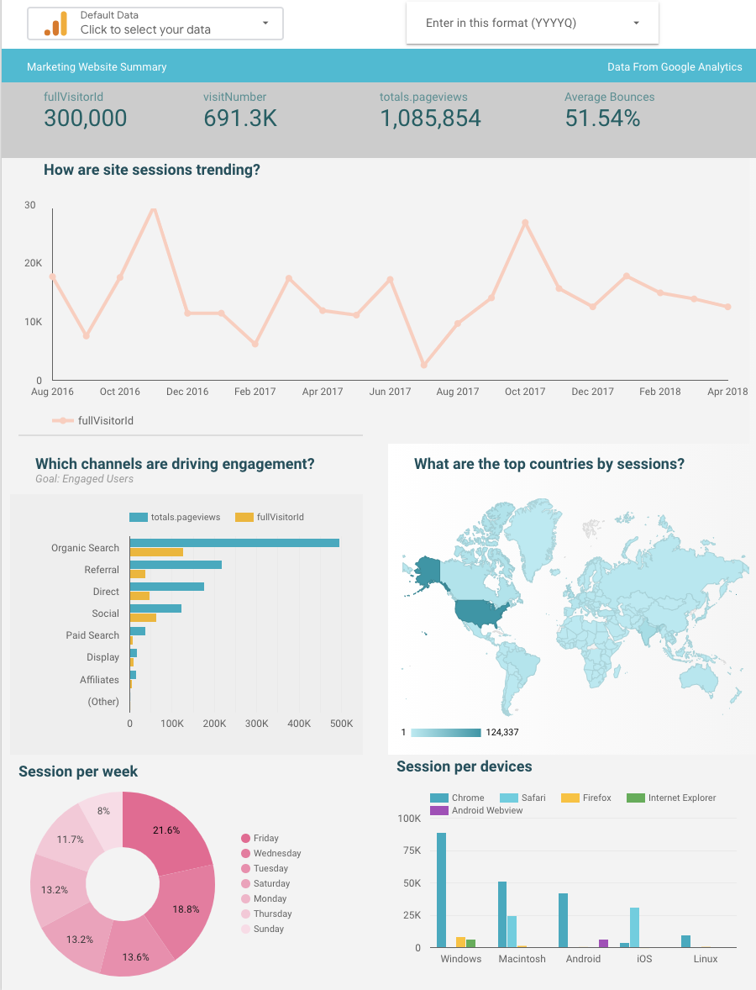
Next steps
Our interactive dashboard is available on Google data-studio for further exploration
Deploy the model to predict if the session brings Revenue
Fin
Techs

Slide 41
Questions & Feedback
Fin
Techs
Hassan Salam
hassansalamb@gmail.com
Linkedin
GitHub
Jonathan Preiss
yonipreiss@gmail.ocm
Linkedin
GitHub
Thank you for your attention!! :)
Sina Lotfiomran
sina.lotfiomran@gmail.com
Linkedin
GitHub
Davain Pablo Edwards
dpedwards@mail.de
Linkedin
GitHub

